Slide 1
Lung Cancer Detector
A Project by Ayush Kumar and Raiman Singh

Slide 2
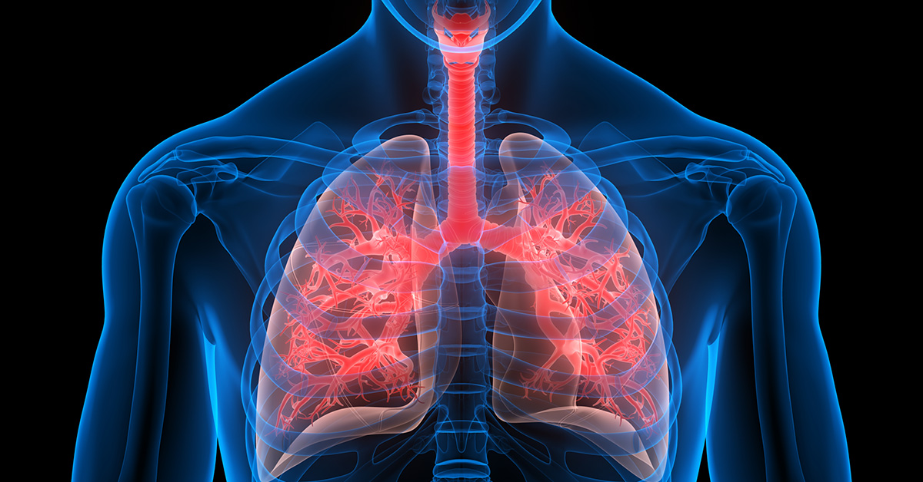
The Problem
Lung cancer is the most often diagnosed cancer and leading cause of cancer-related deaths worldwide.
In India, lung cancer accounts for 5.9% of all cancers and 8.1% of all cancer-related deaths.
Patients with lung cancer generally undergo noninvasive staging by imaging to assess the local and distant extent of disease.
Any evidence of nodal involvement on imaging is generally confirmed by invasive mediastinal staging owing to the possibility of false-positive results.
;

Slide 3

Current Solutions
Low-dose computed tomography (LDCT) of the chest is an established strategy for the screening of lung cancer. However, it is quite expensive and delivers a high dose of radiation
Positron emission tomography (PET)–computed tomography (CT) is often used to characterize lung nodules found during LDCT screening. PET-CT has a high false-positive rate in developing countries such as India owing to infectious conditions limiting its use.
;

Slide 4
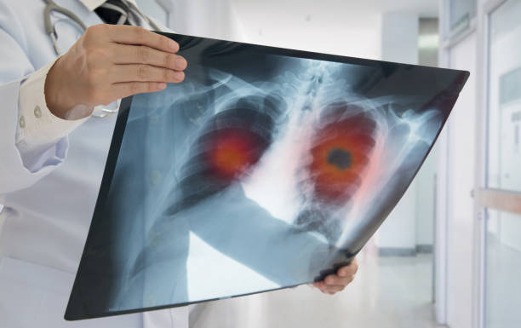
My Solution
Using a data set of thousands of high-resolution lung scans present on Kaggle and various other sources, I have developed a machine learning model that accurately determines when lesions in the lungs are cancerous. This will dramatically reduce the false positive rate that plagues the current detection technology, get patients earlier access to life-saving interventions, and give radiologists more time to spend with their patients.
;

Slide 5
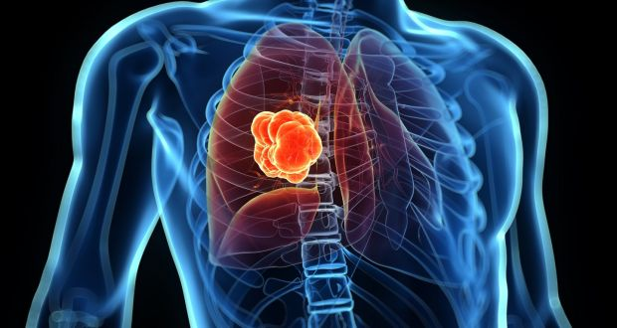
How does the Project work?
The user is asked to upload a CT scan as the input. This input is then passed into the python script which processes it and converts it into an image array.
This Matrix structure is then passed into a machine learning model which classifies the input image as either cancerous or non-cancerous.
The script then returns this output to the flask framework which then displays it on the webpage
;

Slide 6
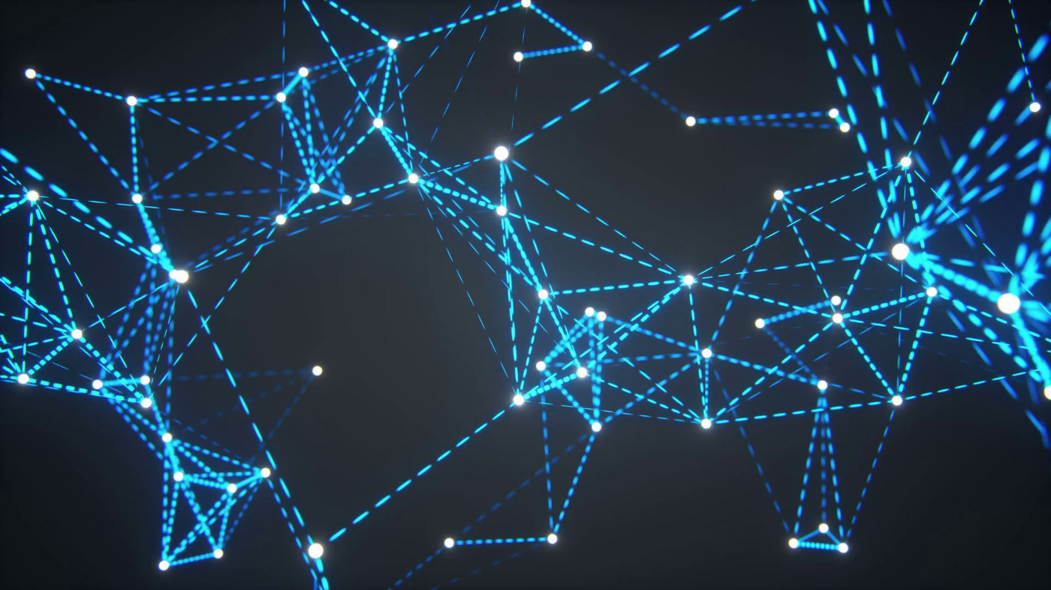
Summary of the Model
________________________________________________________________________
Layer (type) Output Shape Param #
========================================================
input_1 (InputLayer) [(None, 224, 224, 3)] 0
________________________________________________________________block1_conv1 (Conv2D) (None, 224, 224, 64) 1792
________________________________________________________________block1_conv2 (Conv2D) (None, 224, 224, 64) 36928
________________________________________________________________
block1_pool (MaxPooling2D) (None, 112, 112, 64) 0
________________________________________________________________block2_conv1 (Conv2D) (None, 112, 112, 128) 73856
________________________________________________________________
block2_conv2 (Conv2D) (None, 112, 112, 128) 147584
________________________________________________________________
block2_pool (MaxPooling2D) (None, 56, 56, 128) 0
________________________________________________________________
block3_conv1 (Conv2D) (None, 56, 56, 256) 295168
________________________________________________________________block3_conv2 (Conv2D) (None, 56, 56, 256) 590080
________________________________________________________________
block3_conv3 (Conv2D) (None, 56, 56, 256) 590080
________________________________________________________________
block3_pool (MaxPooling2D) (None, 28, 28, 256) 0
________________________________________________________________
block4_conv1 (Conv2D) (None, 28, 28, 512) 1180160
________________________________________________________________block4_conv2 (Conv2D) (None, 28, 28, 512) 2359808
________________________________________________________________
block4_conv3 (Conv2D) (None, 28, 28, 512) 2359808
________________________________________________________________
block4_pool (MaxPooling2D) (None, 14, 14, 512) 0
________________________________________________________________
________________________________________________________________
block5_conv1 (Conv2D) (None, 14, 14, 512) 2359808
________________________________________________________________
block5_conv2 (Conv2D) (None, 14, 14, 512) 2359808
________________________________________________________________
block5_conv3 (Conv2D) (None, 14, 14, 512) 2359808
________________________________________________________________
block5_pool (MaxPooling2D) (None, 7, 7, 512) 0
________________________________________________________________
flatten (Flatten) (None, 25088) 0
________________________________________________________________
dense (Dense) (None, 2) 50178
========================================================
Activation function - Softmax
Optimizer - Adam
Loss Function - Categorical Crossentropy
;

Slide 7
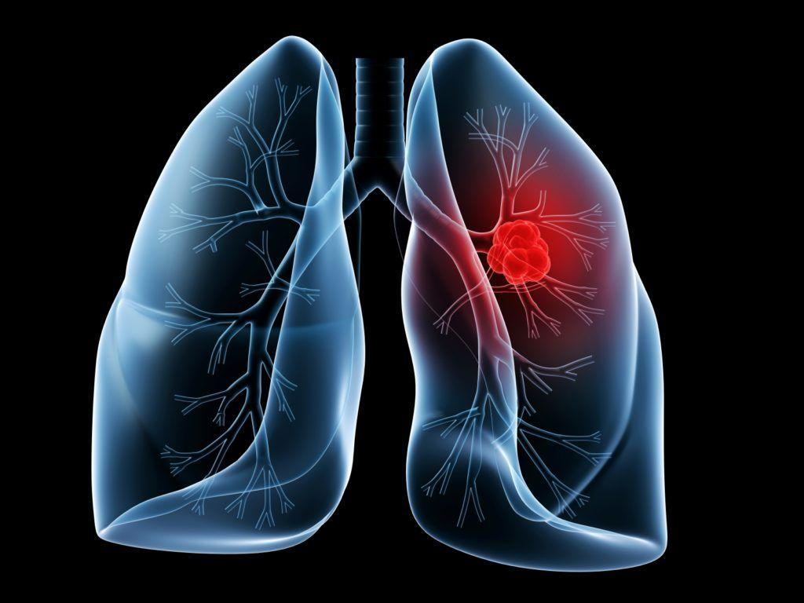
Future of This Project
As the project collects more images and increase it’s datasets, the accuracy of the ML model will continue to increase. This alone makes it an ever evolving system which will continue to improve and help reduce costs in clinics and hospitals.

Slide 8
Thank You
Made by - Me, Myself and I

